Slide 1
Advanced Java Concepts
Regular Expressions (regex)

Slide 2
Introduction
Regular expressions are a way to describe a set of strings based on common characteristics shared by each string in the set.
They can be used to search, edit, or manipulate text and data.
For a given String and a pattern, we either match the pattern to the string(or part of it), and also find which part of pattern matches which part of string.

Slide 3
Package to be imported
“java.util.regex”
This package primarily consists of three classes: Pattern, Matcher, and PatternSyntaxException.
First create a pattern using static compile() methods.
Pattern p = Pattern.compile(“pattern”);
Then create a Matcher using methods from pattern class.
Matcher m = p.matcher(“String”);

Slide 4
Boolean functions
m.matches()
true if pattern matches complete string, else false.
m.LookingAt()
true if pattern matching happens at the beginning.
m.find()
true if any part of pattern is matched by the string.
Subsequent calling will of find will subsequent matches in the string after the previous match and the counter is shifted.

Slide 5
Important methods in Matcher
find()
start()
end()
replaceFirst
replaceAll
reset()
reset(newText)
Group(int n)

Slide 6
Generating Patterns
pqr - matches sequence of given three characters.
[pqr] - any of three given characters.
[^pqr] - any character except these three characters.
[A-Za-z0-9] - any lower/uppercases alphabet or 9 digits.
[patt1][patt2] - the two patterns must match consecutively.
| - ‘or’ between patterns.

Slide 7
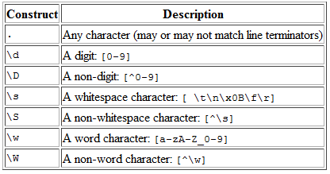
Predefined Quantifiers
Constructs beginning with a backslash are called escaped constructs. If you are using an escaped construct within a string literal, you must precede the backslash with another backslash for the string to compile. For example:
private final String REGEX = "\\d"; // a single digit
Source : http://docs.oracle.com/javase/tutorial/essential/regex/pre_char_classes.html

Slide 8
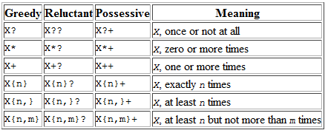
Quantifiers
Quantifiers can be greedy, reluctant or possessive.
Greedy can be converted into reluctant of possessive by appending it with ‘?’ or ‘+’ .
Source : http://docs.oracle.com/javase/tutorial/essential/regex/quant.html

Slide 9
Capturing Groups
Capturing groups are a way to treat multiple characters as a single unit. They are created by placing the characters to be grouped inside a set of parentheses.
For Group numbering count the opening paranthesis :
( ( A ) ( B ( C ) ) ).
1 2 3 4
\0=\1 = ( ( A ) ( B ( C ) ) ).
\2 = ( A ).
\3 = ( B ( C ) ).
\4 = ( C ).

Slide 10
Quantifiers Contd.
Backreferences
backreference is specified in the regular expression as a backslash (\) followed by a digit indicating the number of the group to be recalled.
Eg : To match any 2 digits, followed by the exact same two digits, you would use (\d\d)\1 as the regular expression:
Source :http://docs.oracle.com/javase/tutorial/essential/regex/groups.html

Slide 11
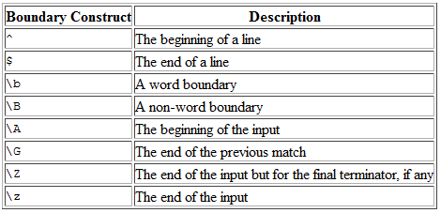
Boundary Matchers
Source : http://docs.oracle.com/javase/tutorial/essential/regex/bounds.html

